Slide 1
Bayesian Inference
Module 3, Lesson 3

Slide 2
More Models and Applications
Shahrzad Jamshidi, PhD

Slide 3
Last Time
Conjugate posterior for normal distribution
Categorical data and corresponding model
Multiple means and variances

Slide 4
Objectives
Analyze logistic regression problems.
Apply Bayesian methods to complex real-world problems.

Slide 5
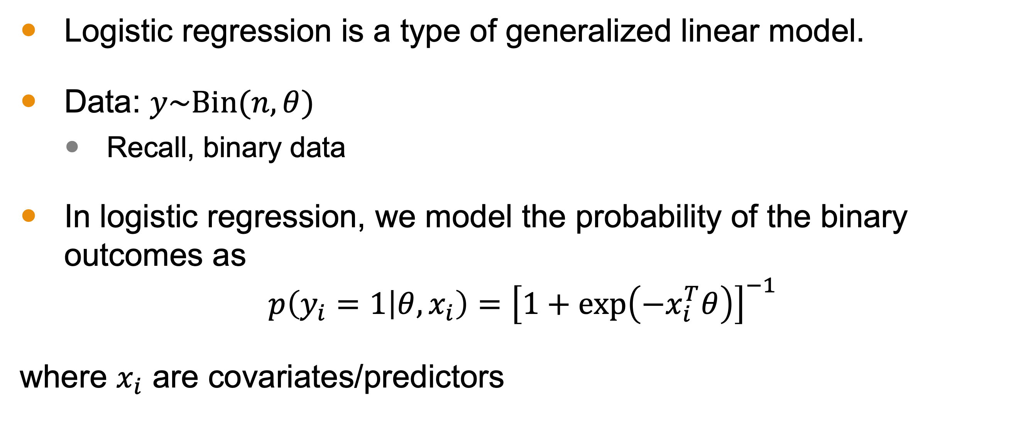
Logistic Regression
Logistic regression is a type of generalized linear model.
Data: $y\sim Bin(n,θ)$
Recall, binary data
In logistic regression, we model the probability of the binary outcomes as
$$p\left(y_{i}=1 | θ,x_{i}\right)={\left[1+exp\left(−x_{i}^{T}θ\right)\right]}^{−1}$$
where $x_{i}$ are covariates/predictors

Slide 6
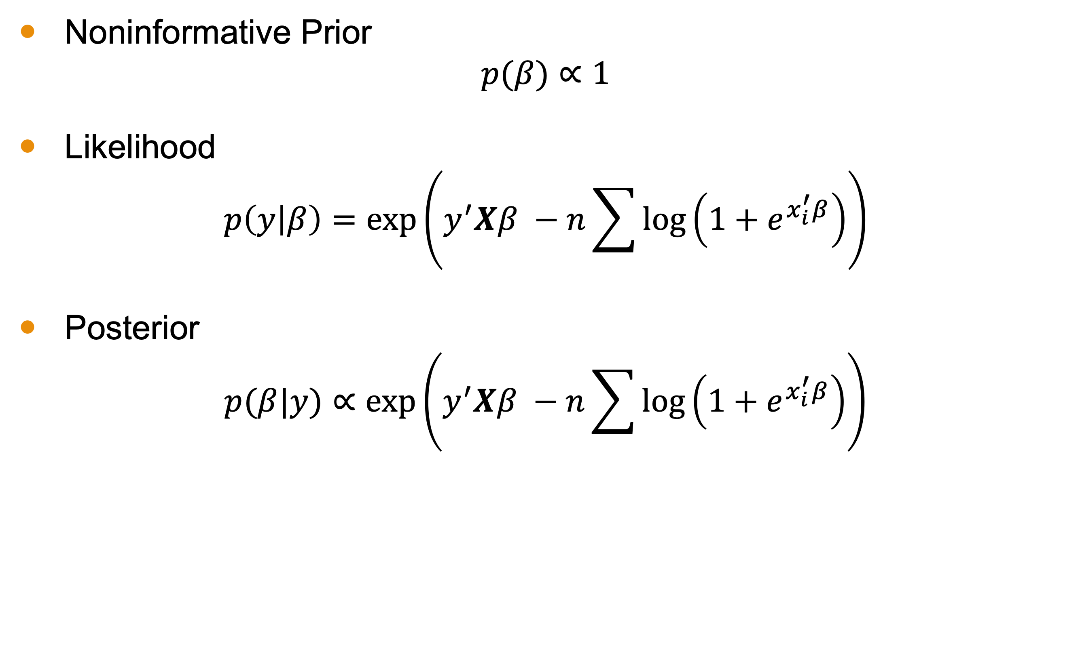
Logistic Regression Summary
Noninformative Prior
$$p(β)∝1$$
Likelihood
$$p\left(y | β\right)=exp\left(y^{′}Xβ −n\sum{\log\left(1+e^{x_{i}^{′}β}\right)}\right)$$
Posterior
$$p(β|y)∝exp\left(y^{′}Xβ −n\sum{\log\left(1+e^{x_{i}^{′}β}\right)}\right)$$

Slide 7
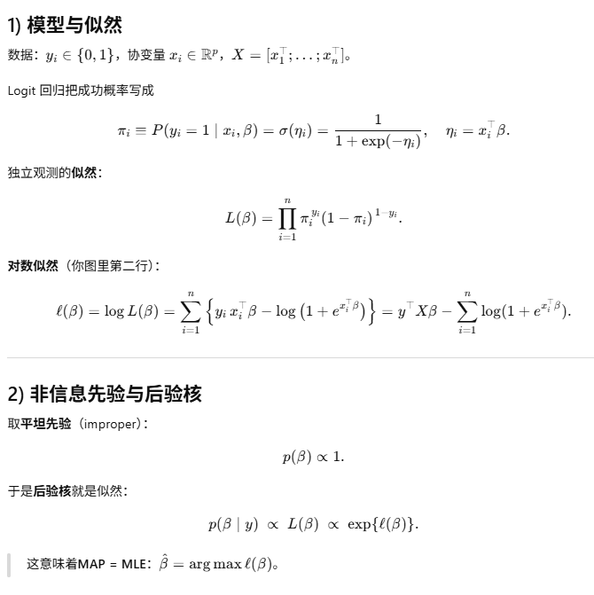
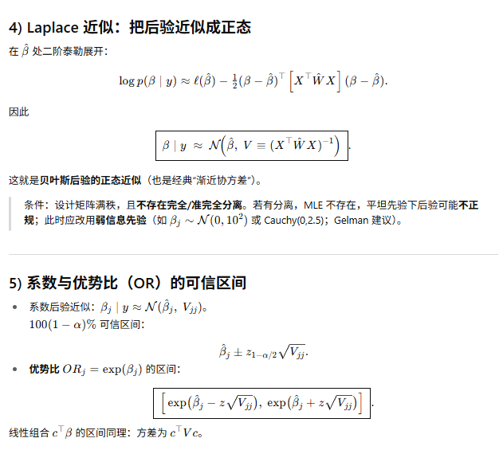
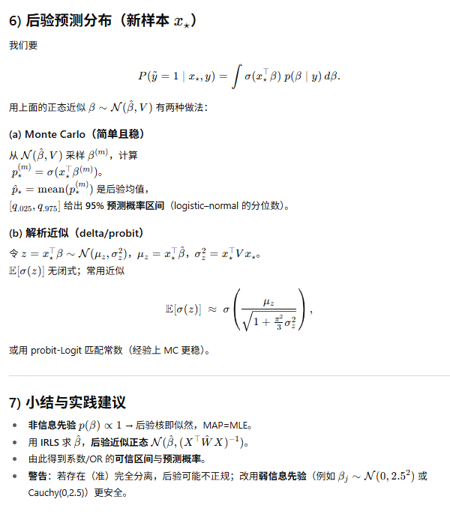
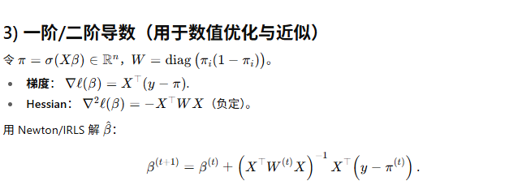
Notes:
Compute the likelihood

Slide 8
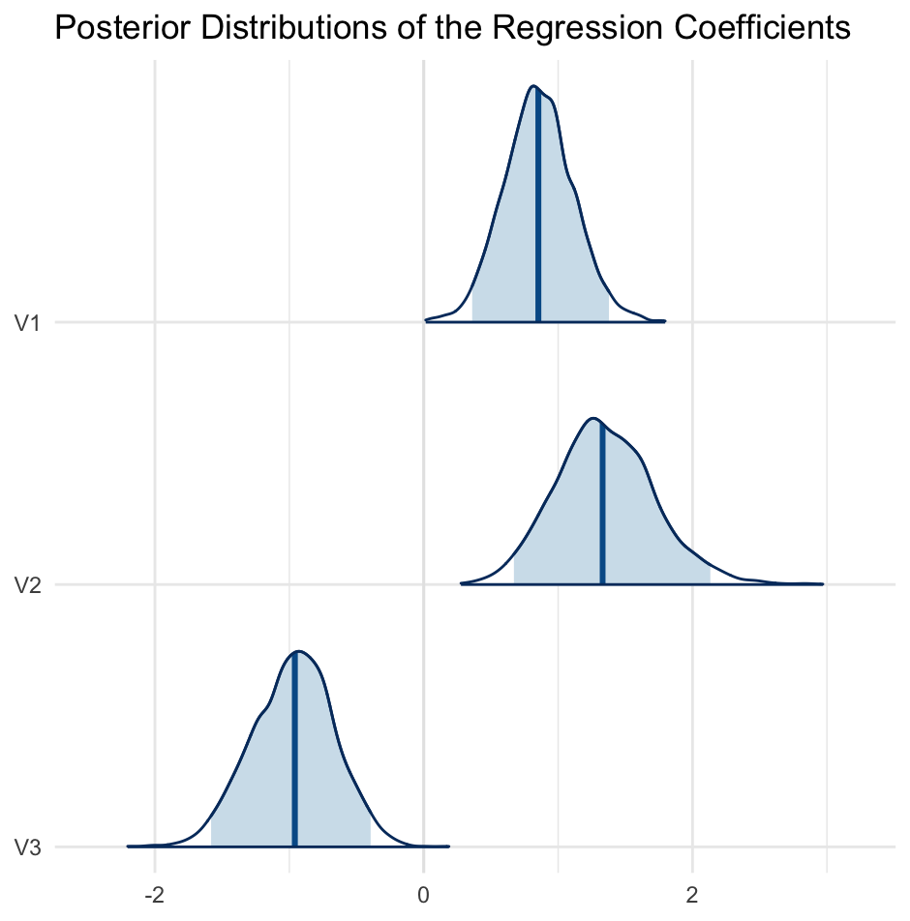
Posterior Sampling
Directly sampling from this posterior distribution is challenging due to its complexity.
We often use Markov Chain Monte Carlo (MCMC) methods in software like Stan.

Slide 9

Example: Analysis of a Bioassay Experiment
It is rare to have simple posterior distributions.
This bioassay experiment illustrates the challenges
A bioassay is an analytical method to determine the effect of a substance on living cells or tissues
Microsoft Stock Images

Slide 10
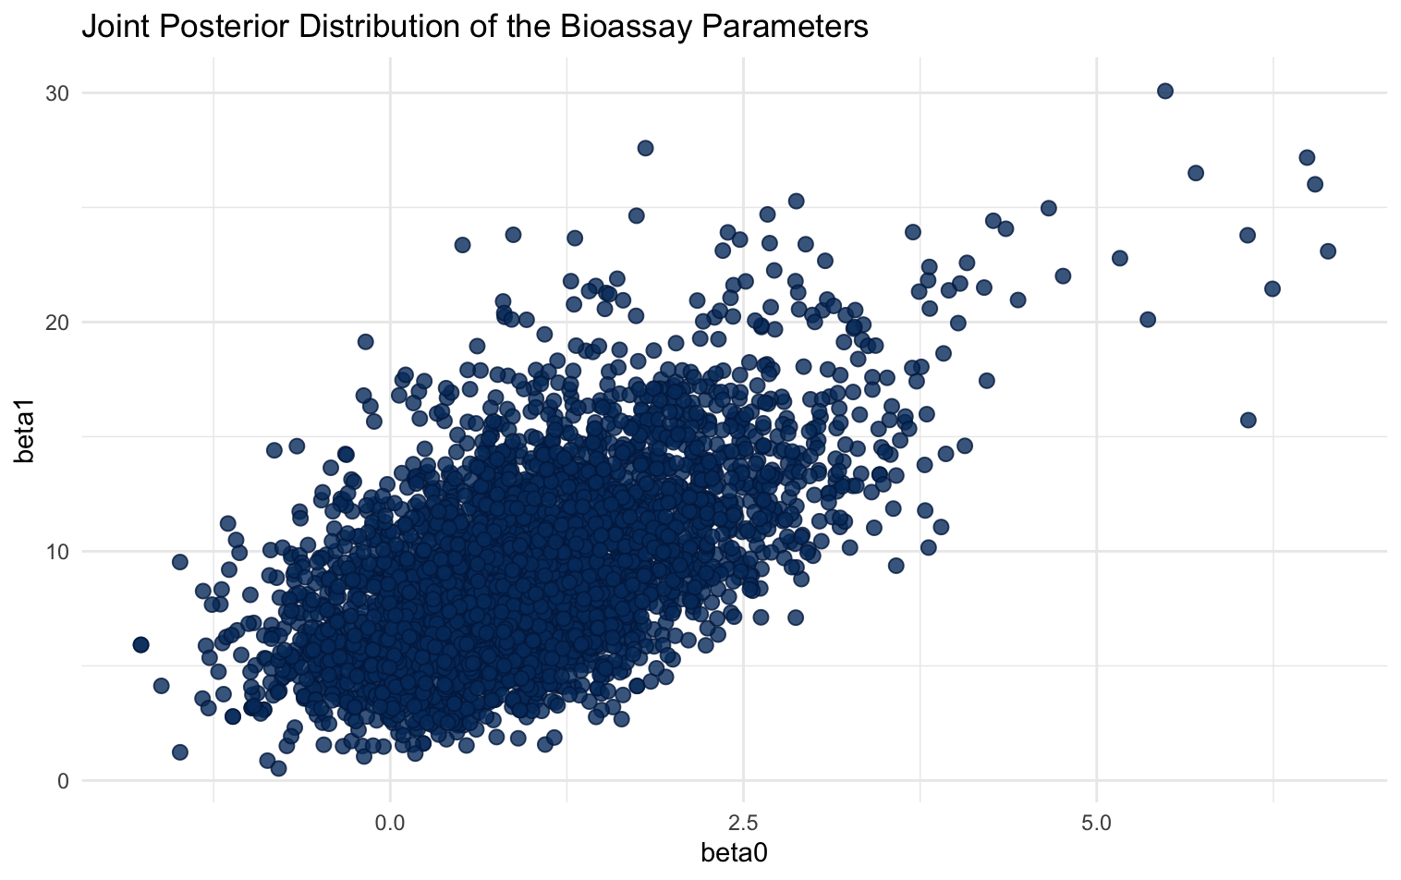
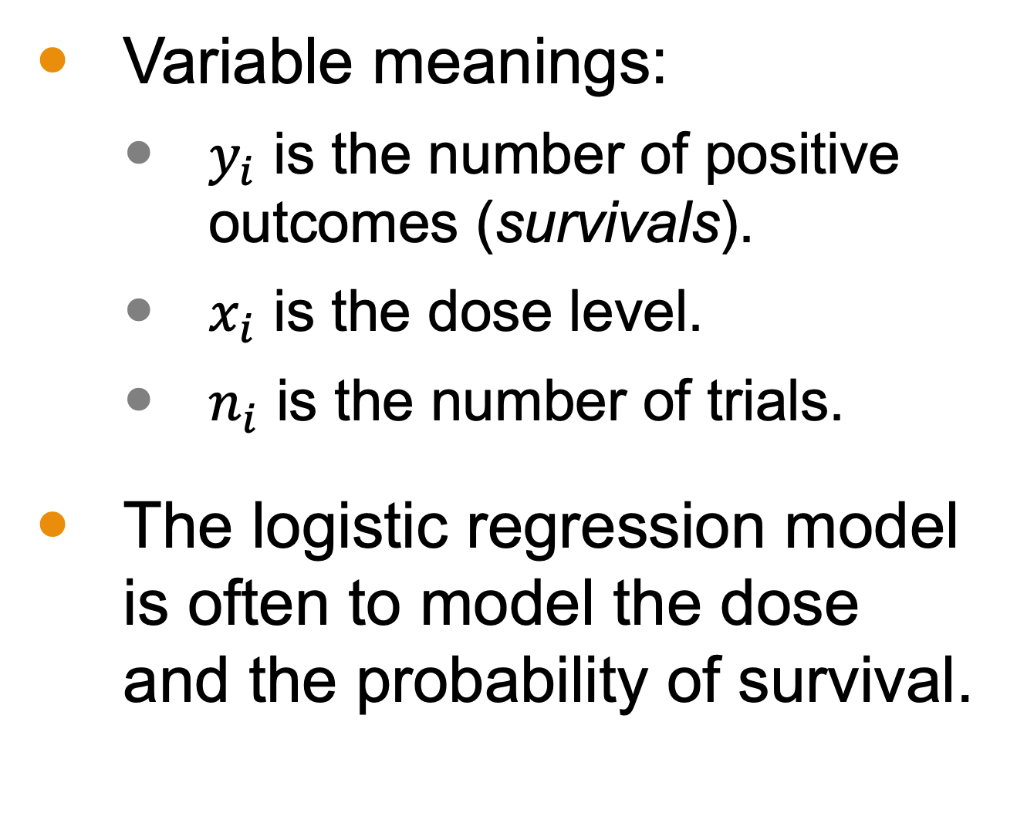
Bioassay Example
Variable meanings:
$y_{i}$ is the number of positive outcomes (survivals).
$x_{i}$ is the dose level.
$n_{i}$ is the number of trials.
The logistic regression model is often to model the dose and the probability of survival.

Slide 11
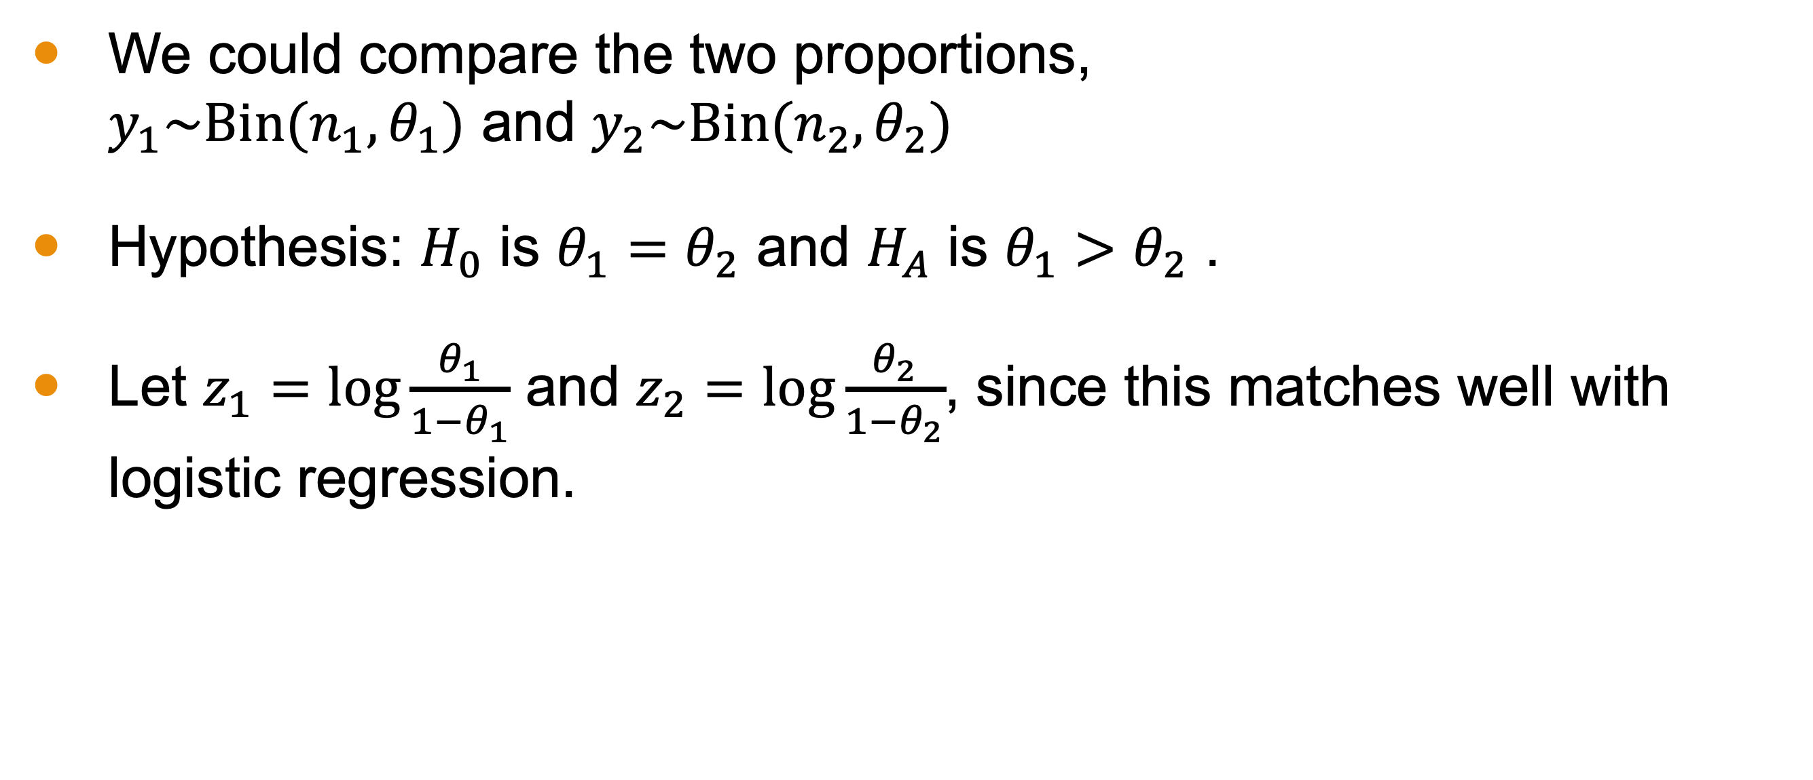
Comparing Two Proportions
We could compare the two proportions, $y_{1}\sim Bin(n_{1},θ_{1})$ and $y_{2}\sim Bin(n_{2},θ_{2})$
Hypothesis: $H_{0}$ is $θ_{1}=θ_{2}$ and $H_{A}$ is $θ_{1}>θ_{2}$ .
Let $z_{1}=log\frac{θ_{1}}{1−θ_{1}}$ and $z_{2}=log\frac{θ_{2}}{1−θ_{2}}$, since this matches well with logistic regression.

Slide 12
(board example inserted here)
Notes:
Compute the example

Slide 13
Multiparameter Models and Considerations
Lack of easily calculable posterior distributions in multiparameter models isn't a significant drawback due to practical reasons.
Simulation methods suffice for obtaining posterior inference in nonconjugate multiparameter models with few parameters.
The bioassay example demonstrates this approach where simulation methods were effectively used for posterior inference.

Slide 14
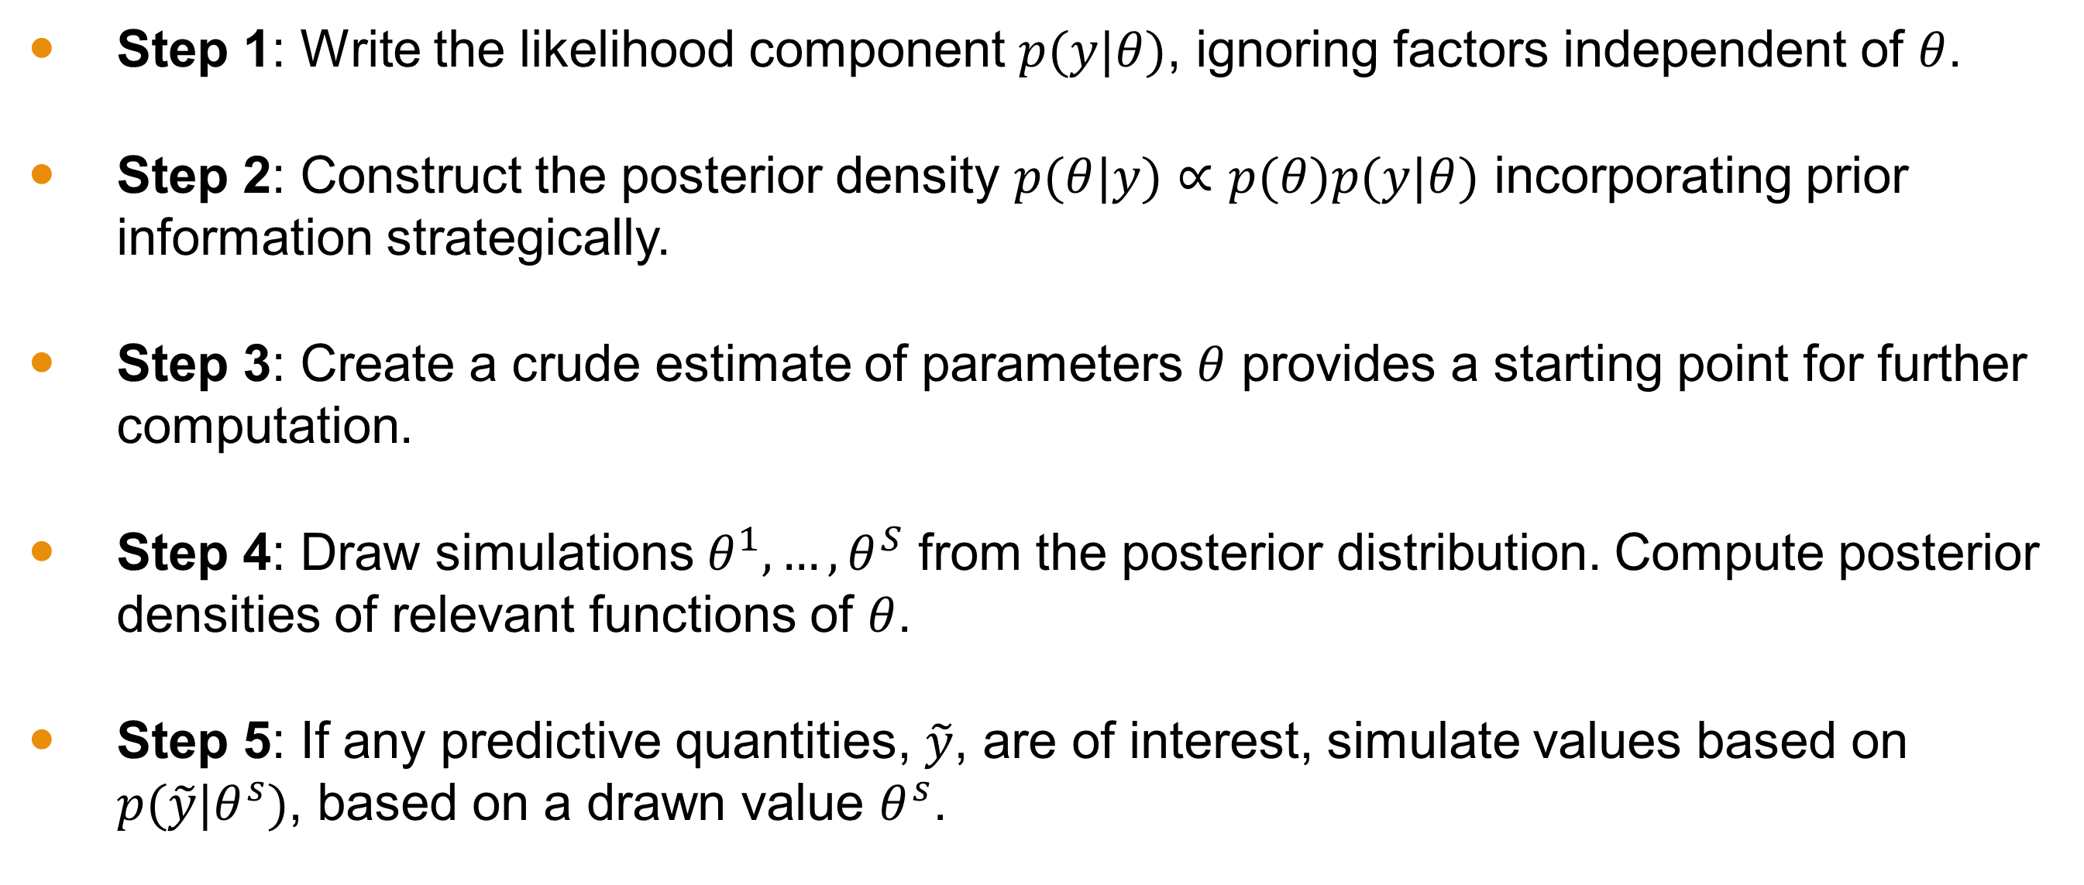
Strategy for Computation
Step 1: Write the likelihood component $p(y|θ)$, ignoring factors independent of $θ$.
Step 2: Construct the posterior density $p(θ|y)∝p(θ)p(y|θ)$ incorporating prior information strategically.
Step 3: Create a crude estimate of parameters $θ$ provides a starting point for further computation.
Step 4: Draw simulations $θ^{1},…,θ^{S}$ from the posterior distribution. Compute posterior densities of relevant functions of $θ$.
Step 5: If any predictive quantities, $\tilde{y}$, are of interest, simulate values based on $p(\tilde{y}|θ^{s})$, based on a drawn value $θ^{s}$.

Slide 15
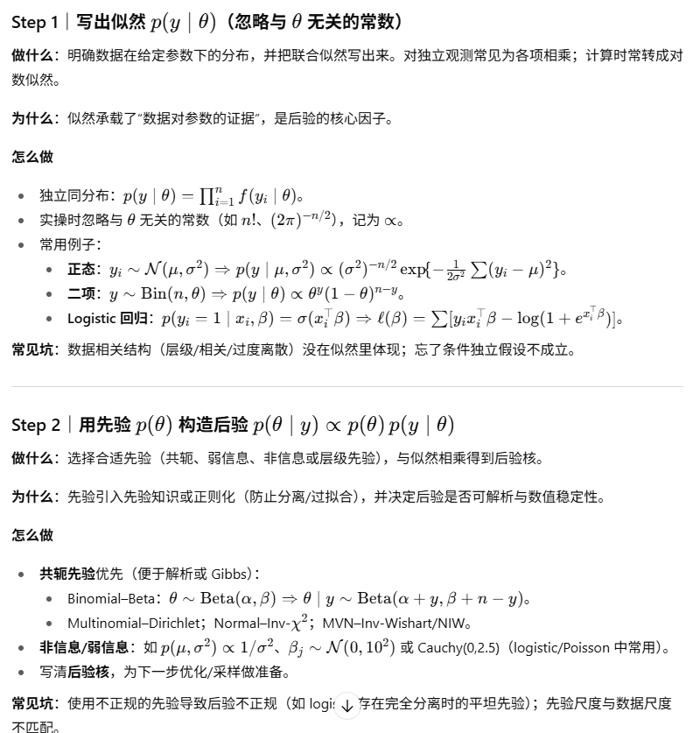
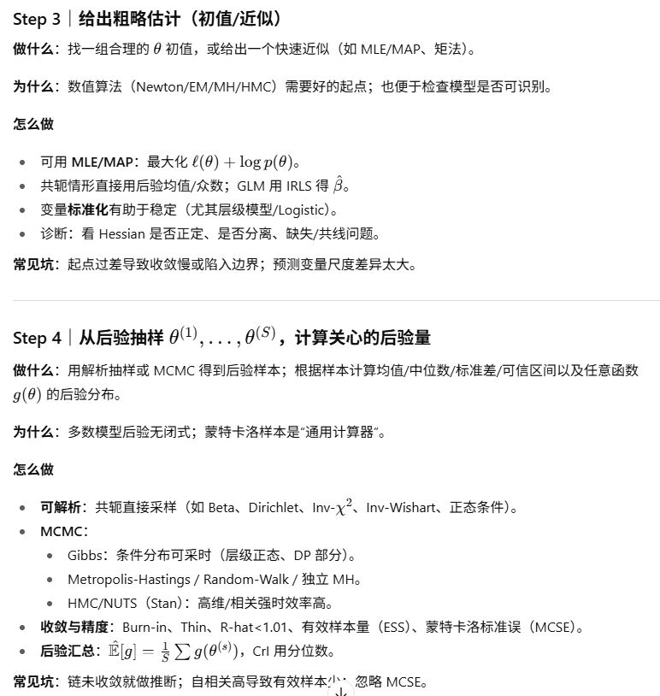
Strategy for Computation

Slide 16
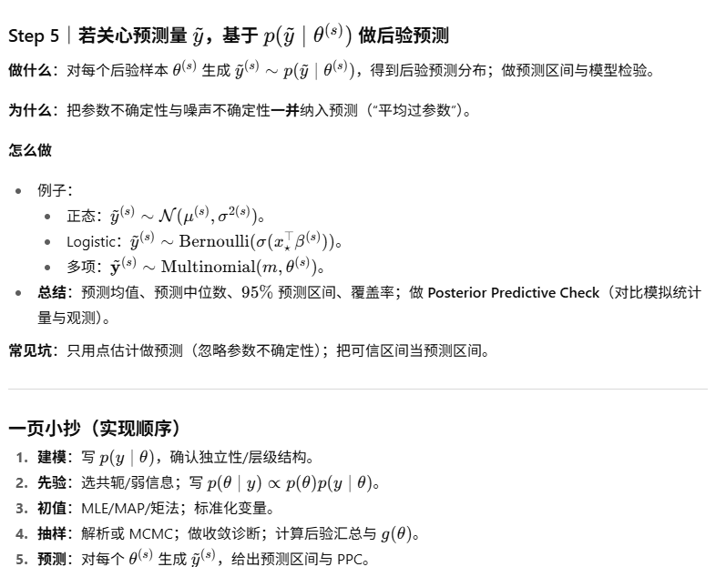
Strategy for Computation

Slide 17
Outline Walk Through
We have data from a clinical trial comparing the success rates of two treatments, A and B. The data are as follows:
Group Treated with A: 35 successes out of 50 trials
Group Treated with B: 45 successes out of 60 trials
We want to estimate and compare the success probabilities for treatments A and B, respectively, using Bayesian methods.

Slide 18

Step 1: Likelihood
Outcomes are binary, so
$$y_{A}|θ_{A}\sim Bin(n_{A},θ_{A})$$
$$y_{B}|θ_{B}\sim Bin(n_{B},θ_{B})$$
Recall: $p\left(y | θ\right)= \left(\begin{matrix}n \\ y\end{matrix}\right)θ^{y}{(1−θ)}^{n−y}$

Slide 19
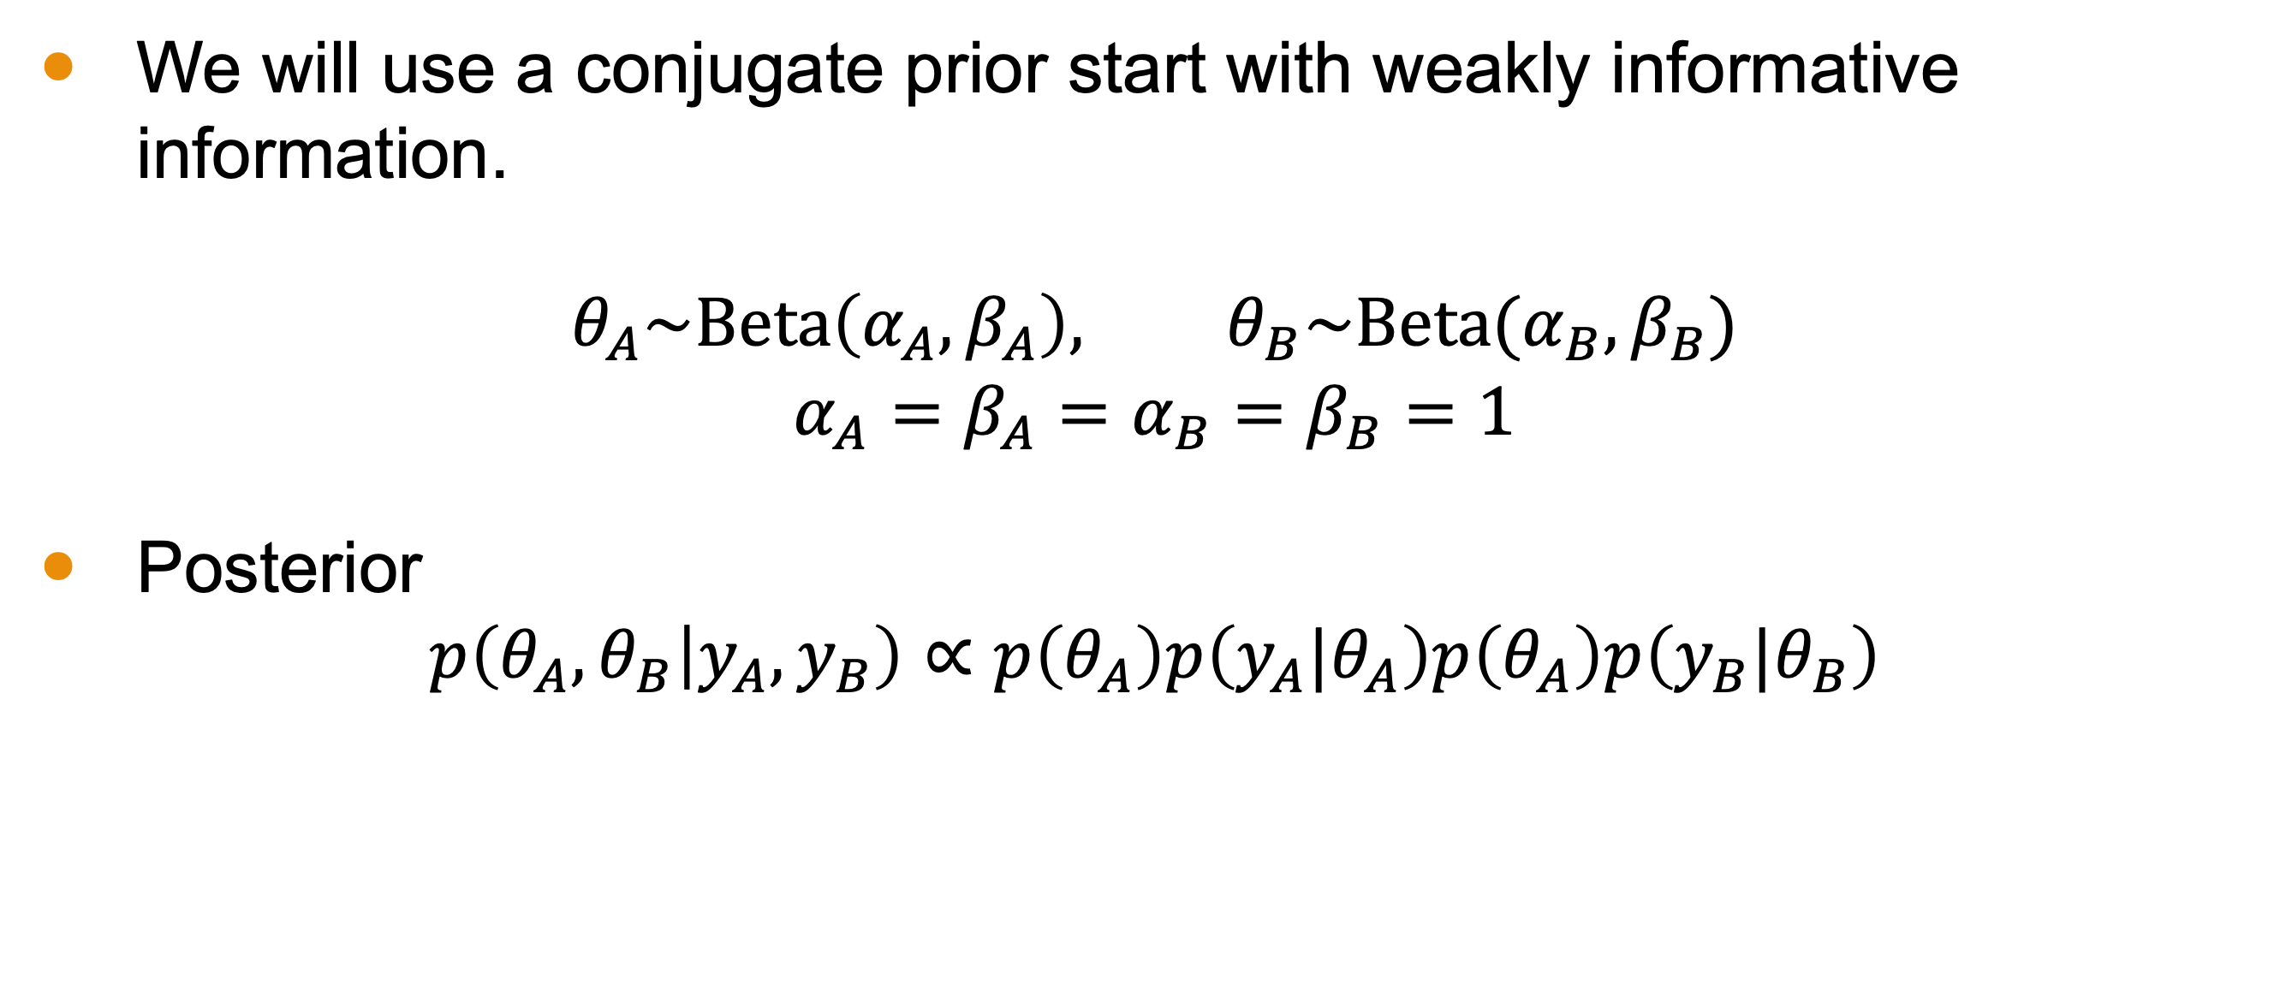
Step 2: Construct Posterior
We will use a conjugate prior start with weakly informative information.
$$θ_{A}\sim Beta\left(α_{A},β_{A}\right), θ_{B}\sim Beta(α_{B},β_{B})$$
$$α_{A}=β_{A}=α_{B}=β_{B}=1$$
Posterior
$$p\left(θ_{A},θ_{B} | y_{A},y_{B}\right)∝p\left(θ_{A}\right)p\left(y_{A}|θ_{A}\right)p\left(θ_{A}\right)p\left(y_{B}|θ_{B}\right)$$

Slide 20

Step 3: Crude Initial Estimates
We can pick initial values of our parameters based on our sample.
${θ_{A}}^{0}=\frac{y_{A}}{n_{A}}$ and ${θ_{B}}^{0}=\frac{y_{B}}{n_{B}}$

Slide 21
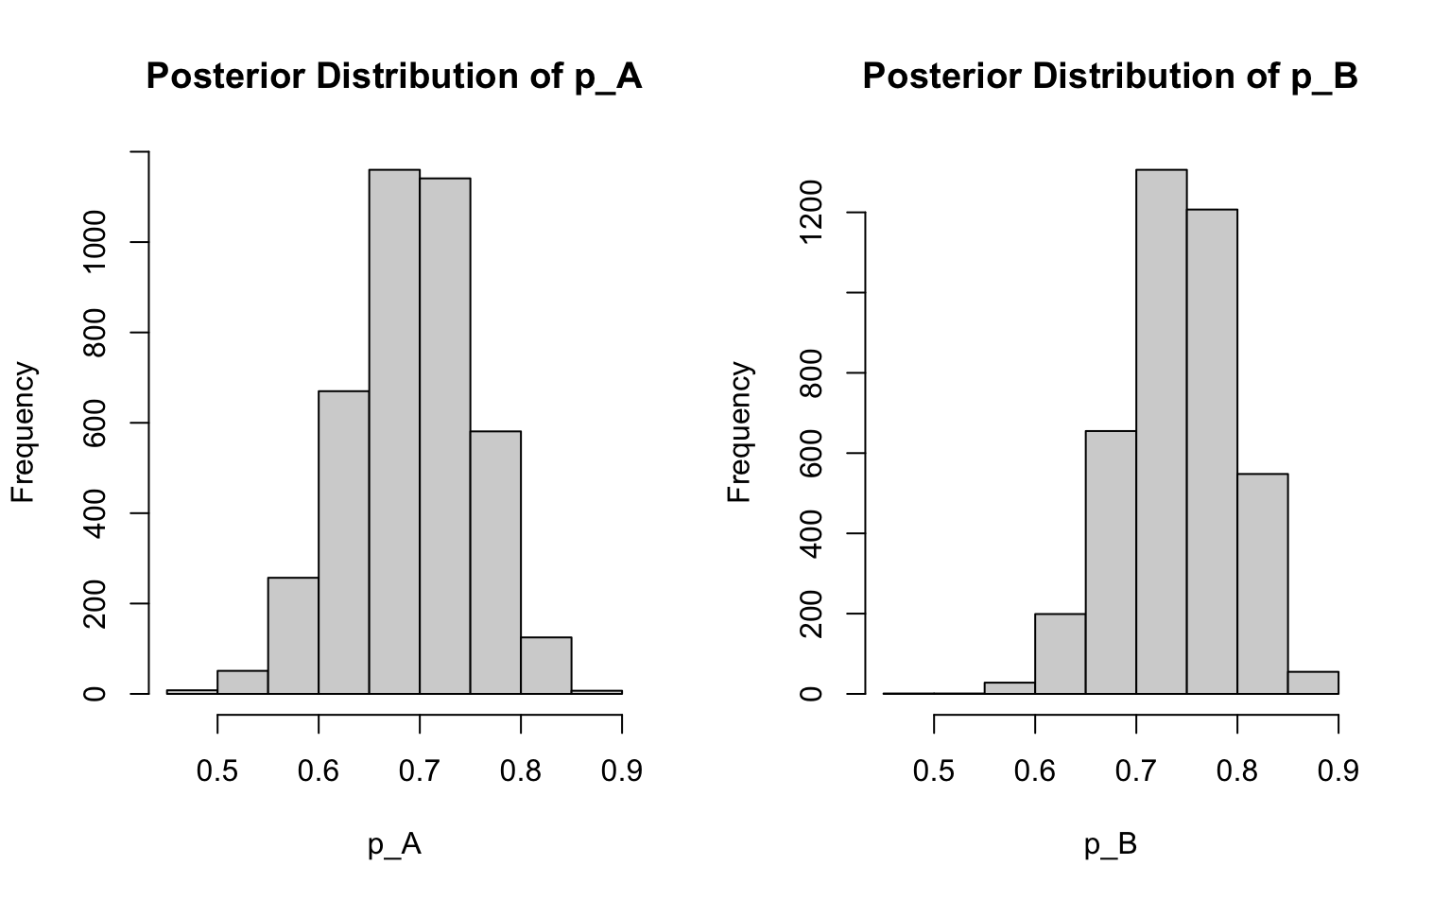
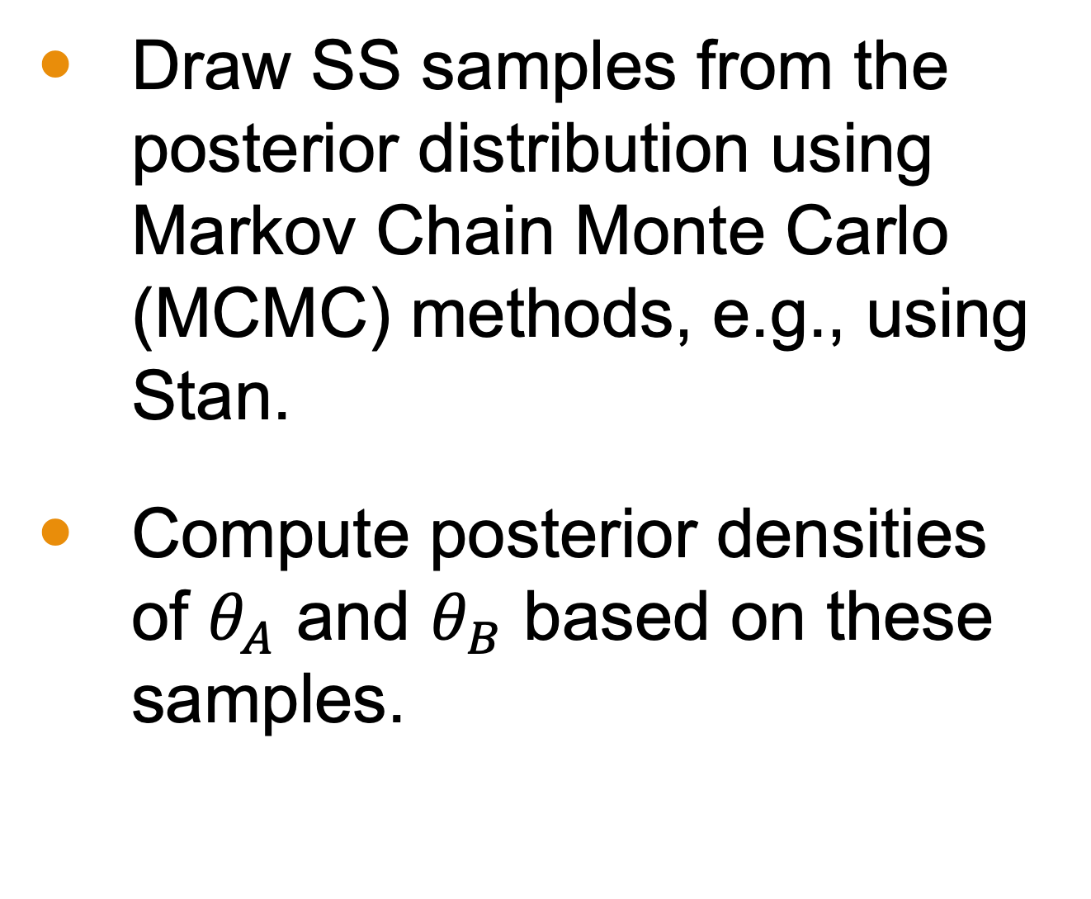
Step 4: Simulation
Draw SS samples from the posterior distribution using Markov Chain Monte Carlo (MCMC) methods, e.g., using Stan.
Compute posterior densities of $θ_{A}$ and $θ_{B}$​ based on these samples.

Slide 22
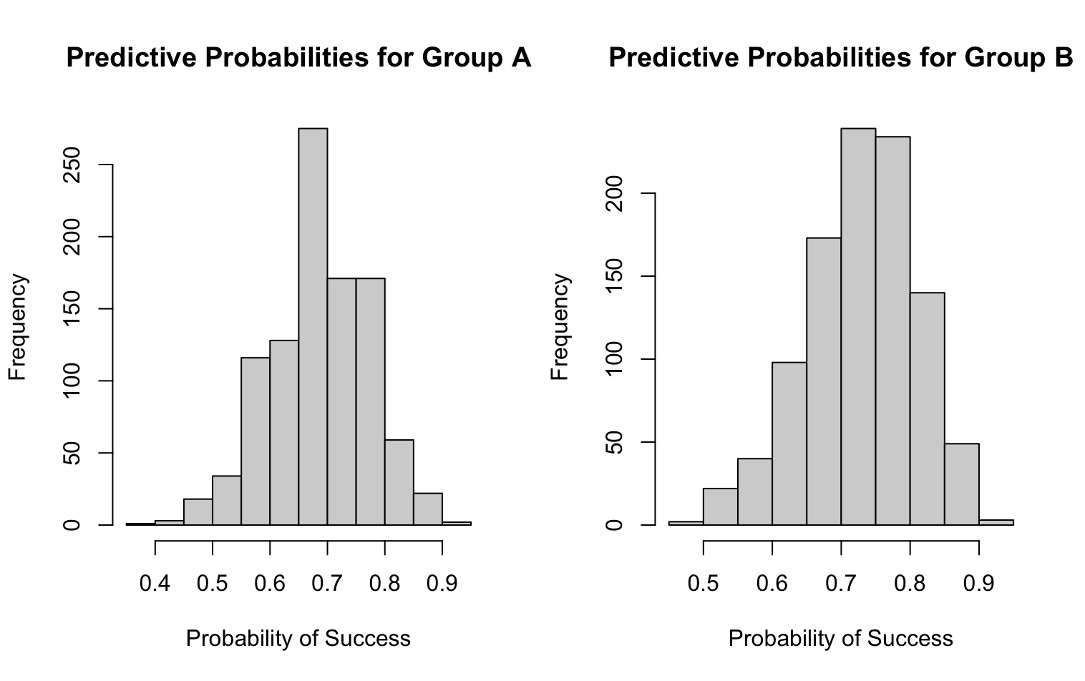
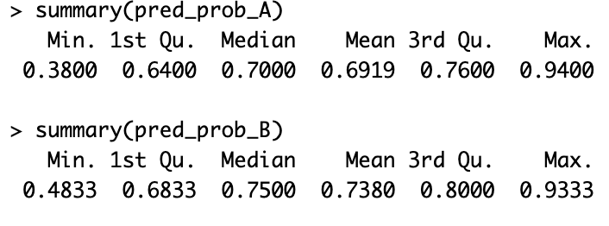
Step 5: Prediction
We can estimate the likelihood of success in the next trial.
We simulate new data from our posterior.

